Slide 1

Development of machine learning models to process Electronic Health Records – Explainable Models
Week 13 Meeting, 18/1/2021

Slide 2
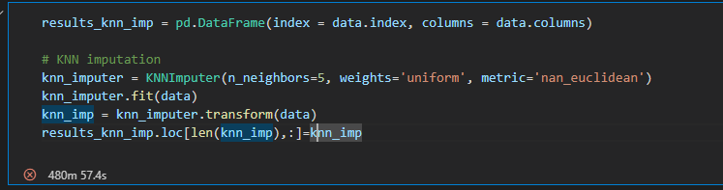
Takes too long to compile
The previous problem exist due to small sample size, when all values are nan the column is skipped, that’s why a smaller size is returned

Slide 3
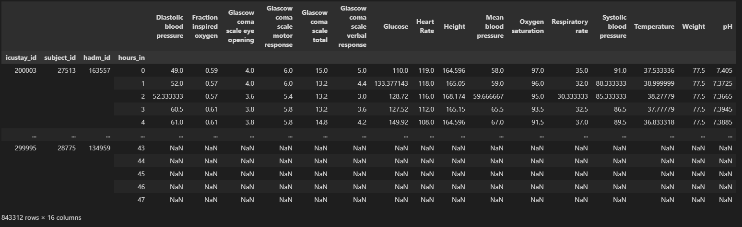
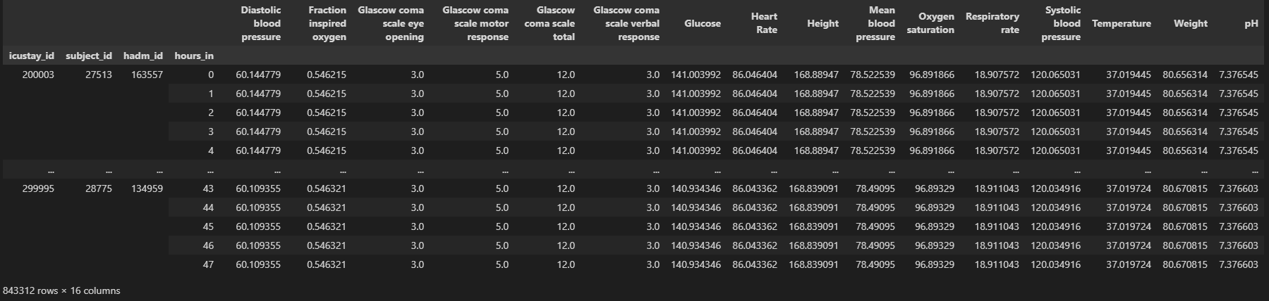
Worked for the first 10000 samples

Slide 4
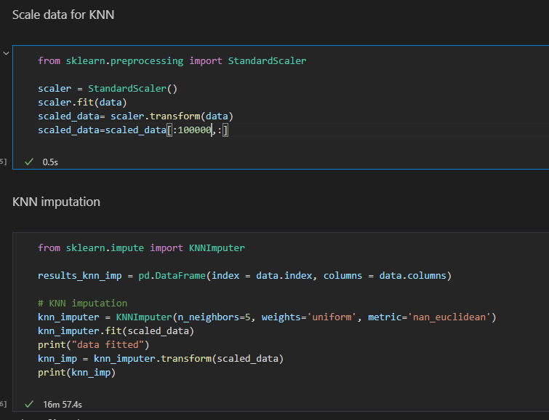
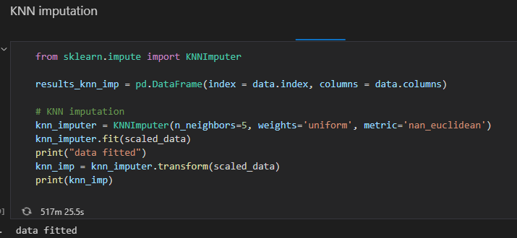
After using standard scaler scaling
100k rows took 16 minutes
But the full 800k samples still takes too long to run

Slide 5
Comparison between different KNN parameters
Even with the same parameters, it gives different values everytime
Keep note on KNN returning different results
Compare -> Quantify and qualify the results
1. performance of logistic regression
2. Masked values (discuss the bias)
Discuss missing values of healthcare data (not random)

